Slide 1
SF CRIME
How true are the claims made by the Recall Chesa Boudin Campaign?
A look into San Francisco's District Attorney's Office: 2019-Present
Graham Galloway
DH100 - Summer 2021

Slide 2
Background
In late 2019 Chesa Boudin, a progressive, restorative justice advocate, won the election to become District Attorney for San Francisco
Since he took office in January 2020 he has faced backlash from critics who claim he is not tough enough on crime
Petitioners started a “Recall Boudin” campaign based on claims that San Francisco is becoming more dangerous
As a long time resident of San Francisco and an advocate for justice reform and critic of mass incarceration myself, I wanted to see if the data supported those claims

Slide 3
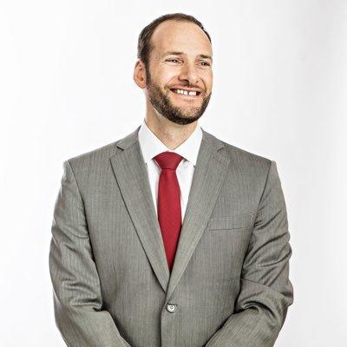
The Recall Campaign’s Claims
Crime has increased in San Francisco since Boudin assumed office
Boudin is letting criminals go free and not pursuing charges as much as his predecessor
San Francisco has been getting more dangerous than other large US cities
Chesa Boudin
Source: twitter.com/chesaboudin

Slide 4
MY METHODS AND DATA
DATA ACQUISITION
OFFICIAL DA CHARGES
CRIME REPORTS
TRIALS
ARRESTS
CRIME COMPARISON
All data is publicly available from data.sf.gov
How many of those arrests are pursued by the DA?
Police crime reports - essentially all crime data
How many cases go to trial and what are the outcomes?
How many of those crimes lead to arrests?
How does SF’s homicide rate compare to other large cities?

Slide 5

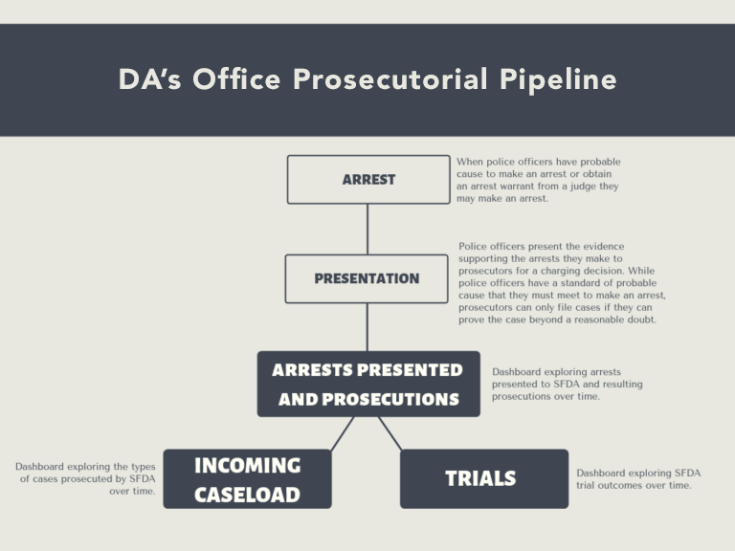
Differences Between the DA and Police

Slide 6
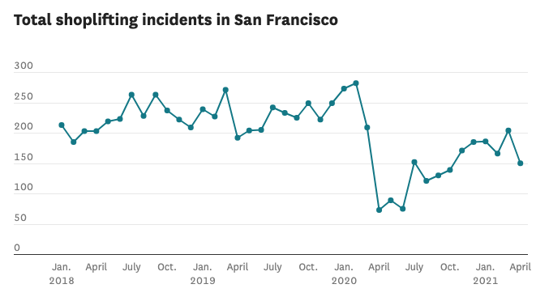
TESTING CLAIM #1
Has crime increased?

Slide 7
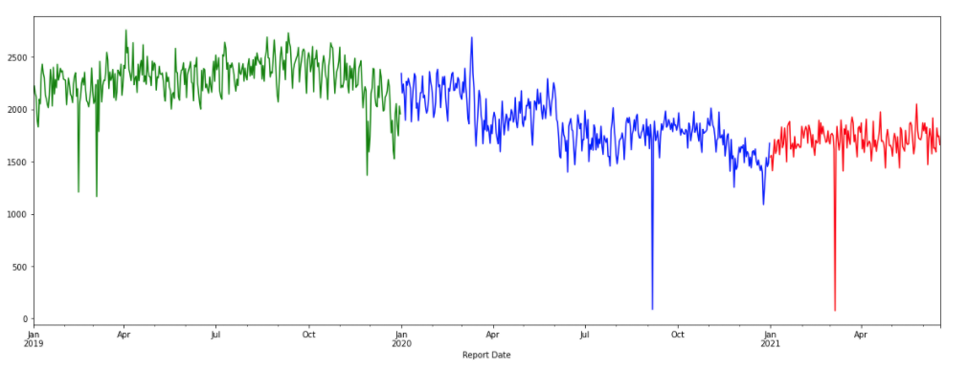
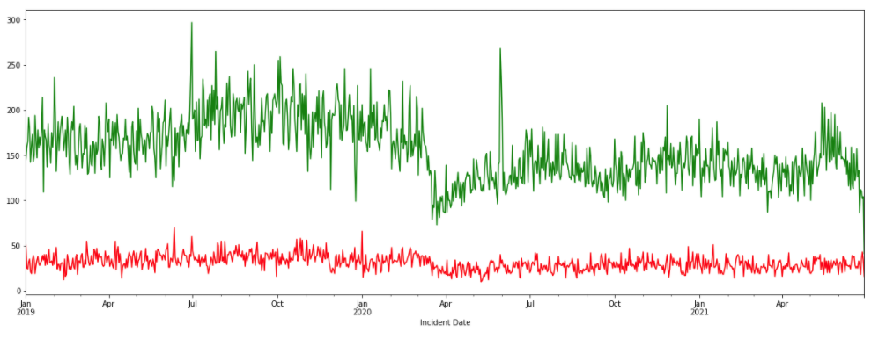
911 Calls by Year. Green=2019, Blue=2020, Red=2021
Violent vs Property crime. Violent=Red, Property=Green

Slide 8
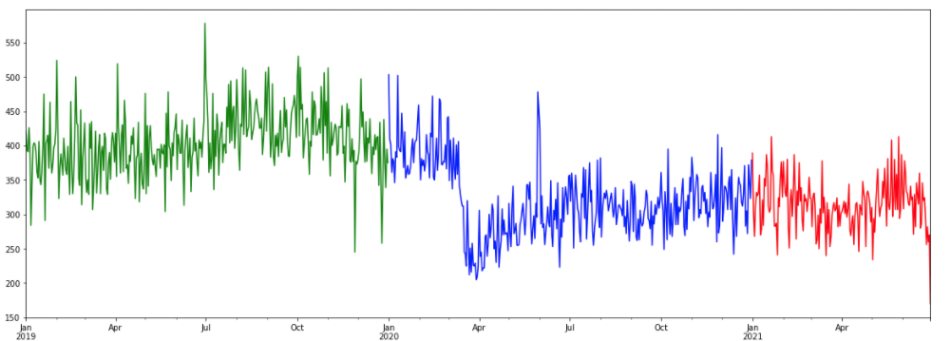
Arrests: Green=2019, Blue=2020, Red=2021

Slide 9

Claim #1:
Source: Wikimedia Commons

Slide 10
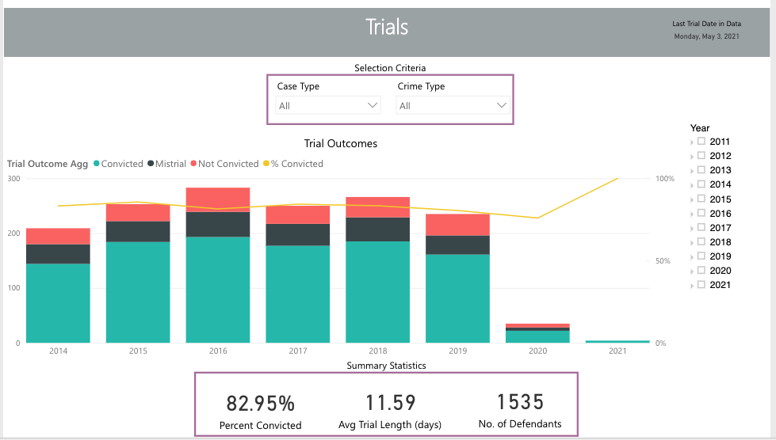
CLAIM #2
CHESA BOUDIN IS NOT PROSECUTING CRIMINALS

Slide 11
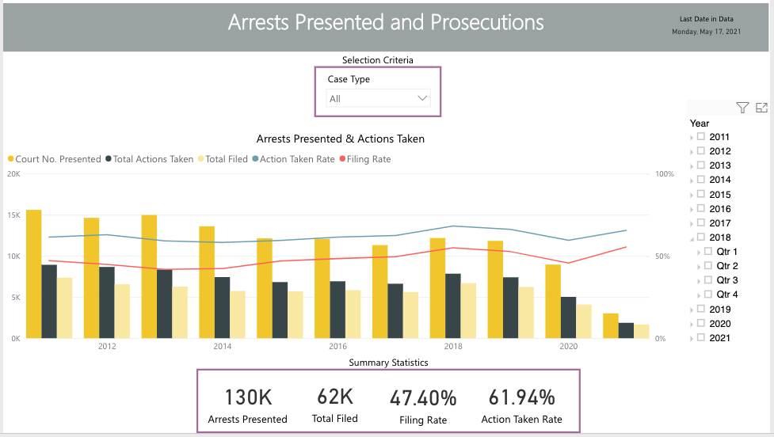
Boudin pursued a smaller percentage of cases in 2020, but is pursuing more so far in 2021

Slide 12

CLAIM #2:
Source: Wikimedia Commons

Slide 13
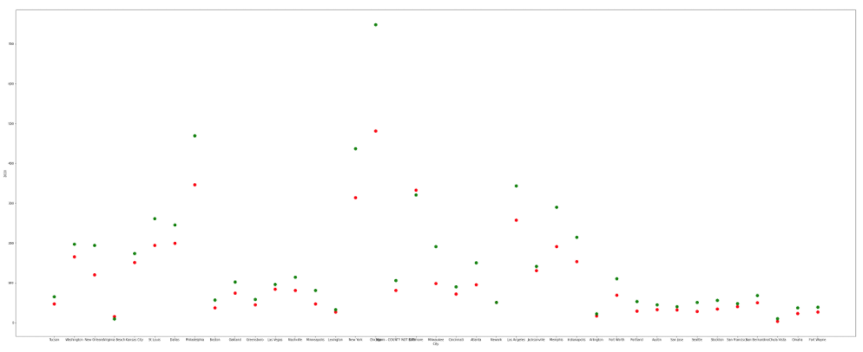
CLAIM #3: SAN FRANCISCO IS BECOMING MORE DANGEROUS THAN OTHER CITIES
Red = 2019 numbers
Green = 2020 numbers
San Francisco
Total Homicides for 39 most populous US cities, 2020 vs 2019

Slide 14
Claim #3:
Source: Wikimedia Commons

Slide 15
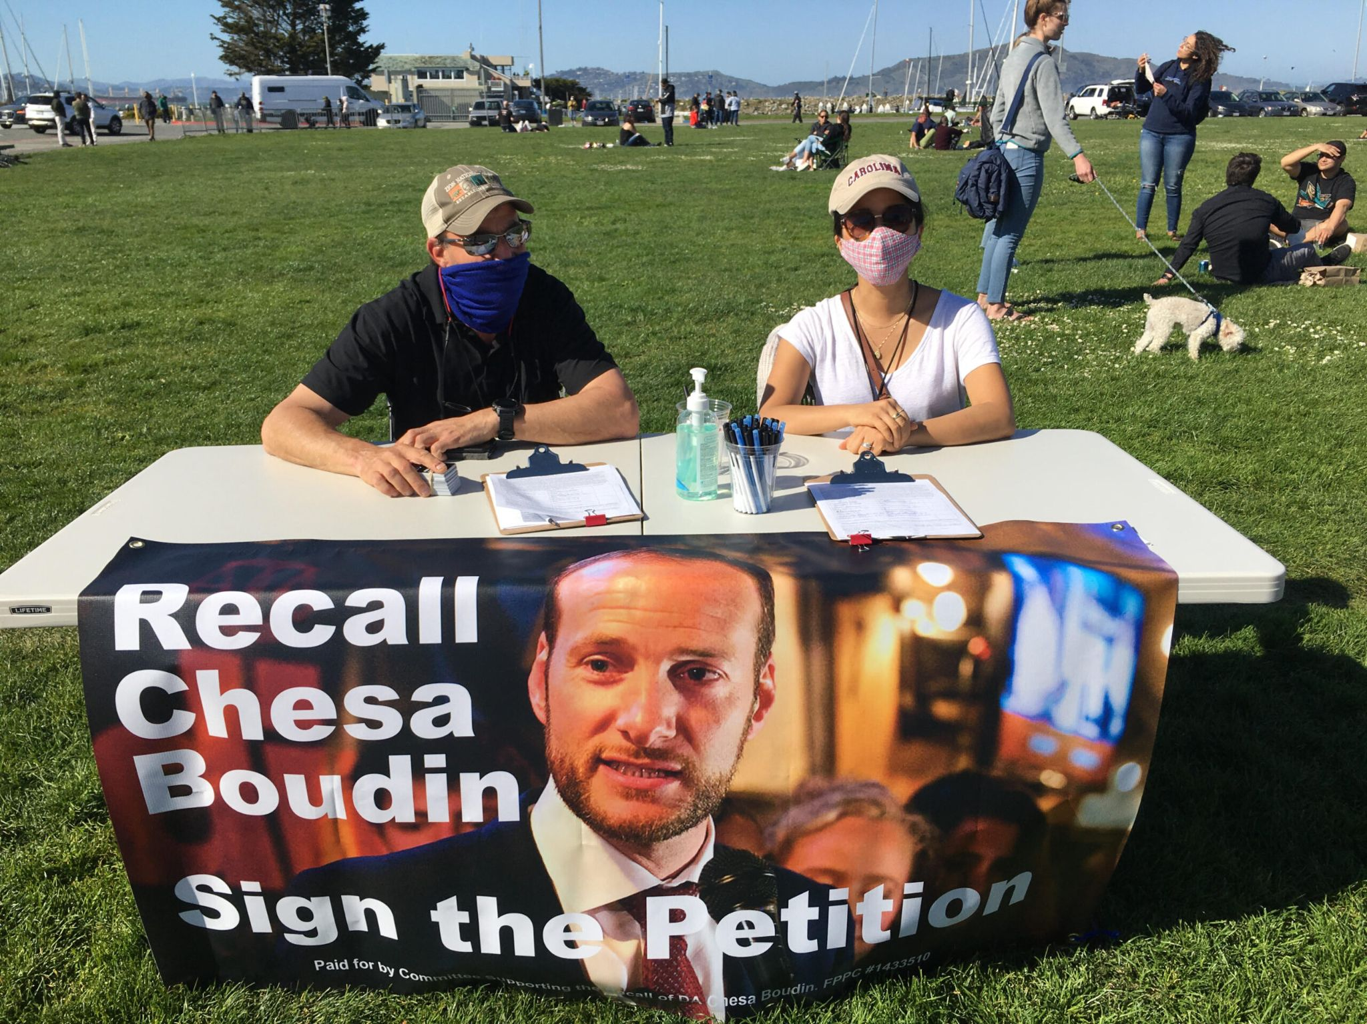
Conclusion:
The three main claims made by the Recall Chesa Boudin campaign are not supported by the publicly available data.
Source: recallchesaboudin.org

Slide 16
Works Cited
data.sf.gov
https://www.fbi.gov/services/cjis/ucr
Washington Post - Opinion: The Bogus Claims Against Progressive Prosecutors
https://recallchesaboudin.org/
twitter.com/recallchesa
twitter.com/chesaboudin
BallotPedia - Recall Chesa Boudin Campaign
https://github.com/Grahambert/DH100

